Slide 1
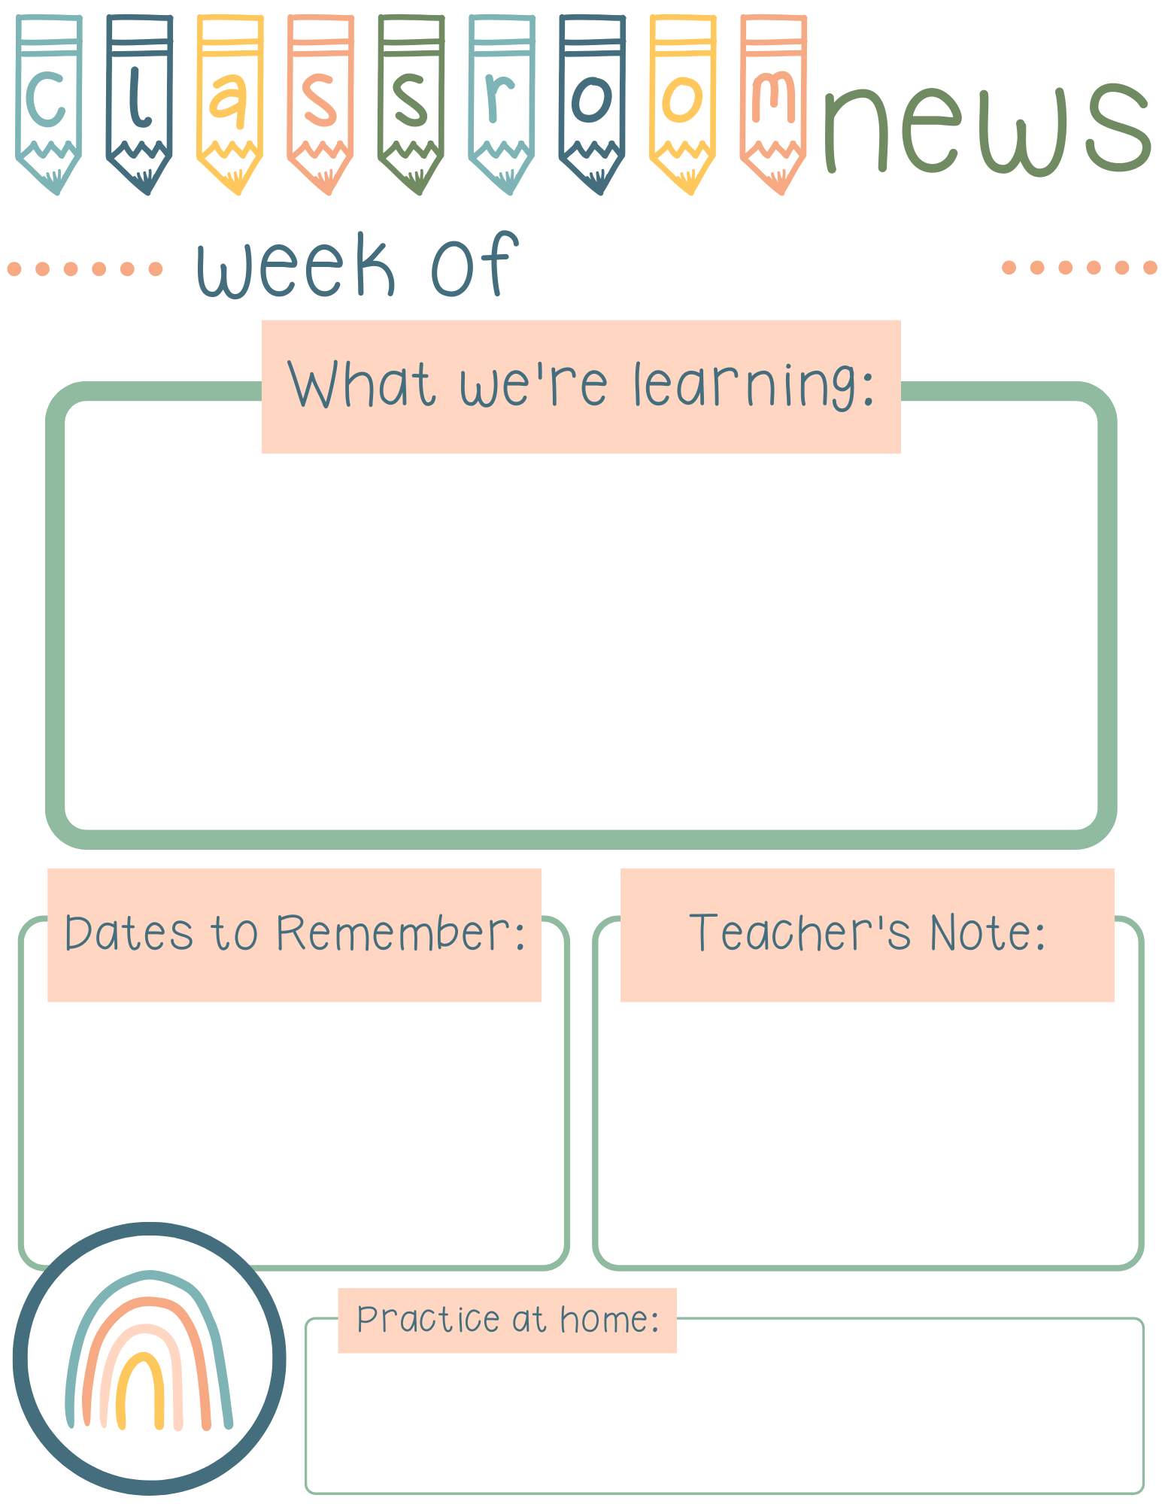
October 31, 2022
READING
Letters: Hh & Tt
Sight Words:
a, the, and, go, had, he, I, see, has, you, we, of, am, at, to
Comprehension Skill:
Making Connections & Summarizing
MATH
Problem Solving
Numbers 11-20
Counting to 50
Thursday November 10, 2022 @ 5:30 Fall Festival; information to come
NO SCHOOL ON FRIDAY NOVEMBER 11, 2022; VETERANS DAY
Kindergarten Powwow November 17, 2022; information to come
Send in one shoe lace & feathers
PLEASE sign and return report cards.
Join Remind 81010 @mrsadlersk
Your child should bring home a Pre-Decodable at least once a week, please listen to them read and sign the decodable.
Please practice letter naming, high frequency words, and numbers naming Monday-Thursday.

